Slide 1
KWS Data Collection / Pre-Processing

Slide 2


Slide 3


Collect
Data
Preprocess
Data
Design a
Model
Train a
Model
Evaluate
Optimize
Convert
Model
Deploy
Model
Make
Inferences
Micro
Notes:
But we need to also consider collecting data and preprocessing the data and designing a model

Slide 4
Collect
Data
Preprocess
Data
Design a
Model
Train a
Model
Evaluate
Optimize
Convert
Model
Deploy
Model
Make
Inferences
Micro
Notes:
But we need to also consider collecting data and preprocessing the data and designing a model

Slide 5


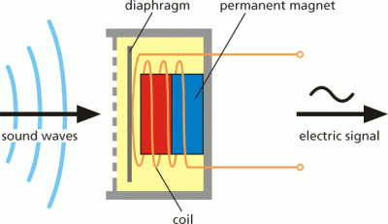
Sensor Data
Coil / Magnet
Sound Waves
Diaphragm
Electric Signal
Notes:
Microphone --- how does it work -> ANALOG SIGNAL!!!!
SOUND: https://thenounproject.com/search/?q=sound&i=1494897
COIL: https://thenounproject.com/search/?q=coil&i=2038001

Slide 6
Sensor Data
16kHz signal
Coil / Magnet
Sound Waves
Diaphragm
Electric Signal
Notes:
want to say that ideally we want to feed this signal into the neural network but how do we do that?

Slide 7
Sensor Data
16kHz signal, so that’s 16000 samples (points / second)
16kHz signal

Slide 8
Sensor Data
16kHz signal, so that’s 16000 samples (points / second)
How do you feed all of that data into the network?
16kHz signal

Slide 9
Sensor Data
16kHz signal, so that’s 16000 samples (points / second)
How do you feed all of that data into the network?
Need to think creatively about the input signal!
16kHz signal

Slide 10
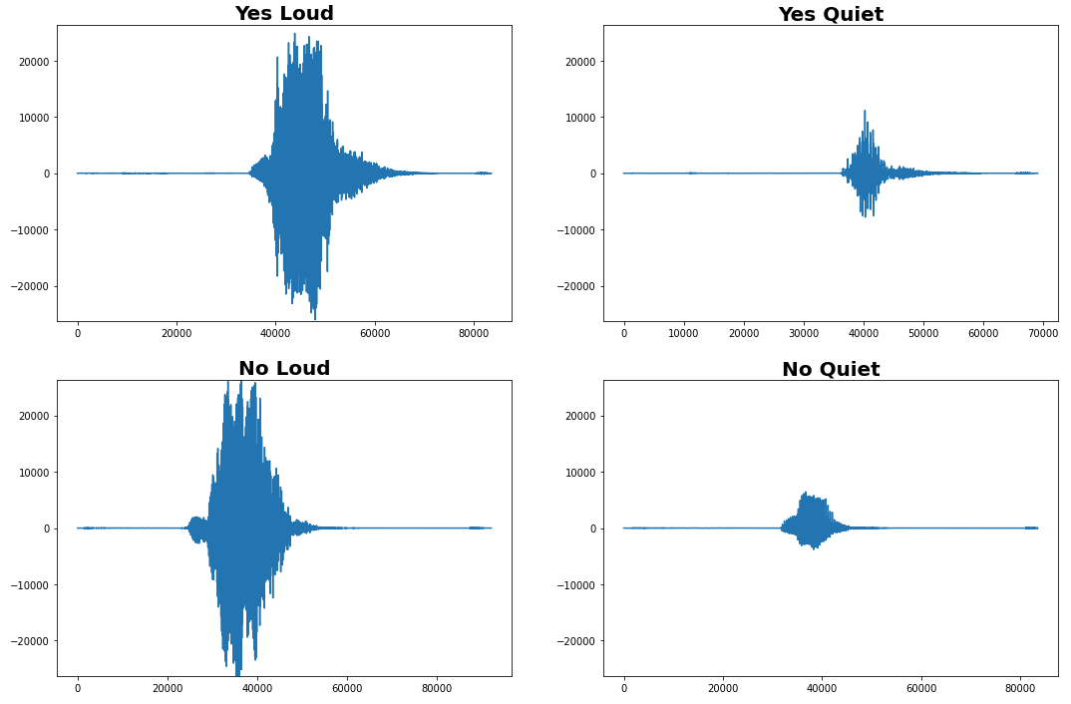
“No” (spoken loudly)

Slide 11
“No” (spoken loudly)

Slide 12
“No” (spoken loudly)
“No” (spoken quietly)

Slide 13
“No” (spoken loudly)
“No” (spoken quietly)

Slide 14
Guess!
Notes:
show these and ask if they know what's what?

Slide 15
What are interesting challenges?
“No” (spoken loudly)
It is a continuous signal, so when does the word start?
Notes:
trying to pose questions for the students before we just tell them what needs to be done.
Any other interesting questions that pose as challenges in how to analyze an audio signal?

Slide 16
What are interesting challenges?
“No” (spoken loudly)
It is a continuous signal, so when does the word start?
How do you “align” on the starting point?
Notes:
trying to pose questions for the students before we just tell them what needs to be done.
Any other interesting questions that pose as challenges in how to analyze an audio signal?

Slide 17
What are interesting challenges?
“No” (spoken loudly)
It is a continuous signal, so when does the word start?
How do you “align” on the starting point?
How do we extract the vital parts of the signal that matter?
Notes:
trying to pose questions for the students before we just tell them what needs to be done.
Any other interesting questions that pose as challenges in how to analyze an audio signal?

Slide 18
How can we differentiate
the signals?

Slide 19
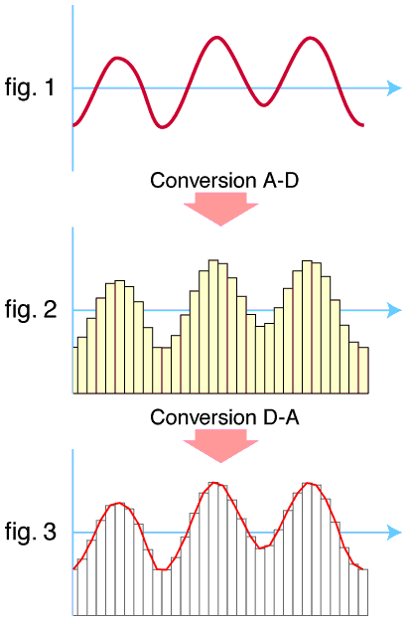
Sensor Data
16Khz signal
A-to-D Conversion
Coil / Magnet
Sound Waves
Diaphragm
Electric Signal
Notes:
Then need to take the analog signal and bin it to convert to a digital signal the computer can recognize
Maybe make a note that higher quality audio has more bins? Different hardware have higher qualility A2D hardware?

Slide 20
Data Preprocessing
“No” (spoken loudly)
“No” (spoken quietly)
Notes:
Can we tell these are different? Are they the same? This is hard!
What are the fundamental features we can find in these signals?

Slide 21
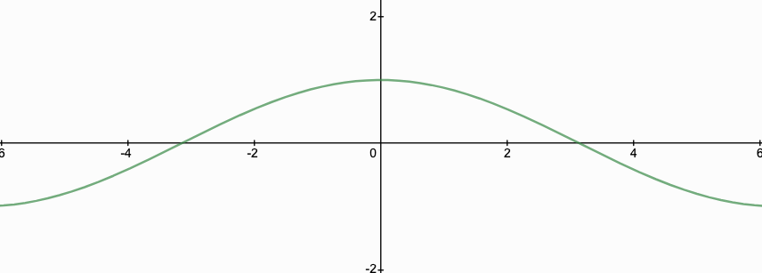
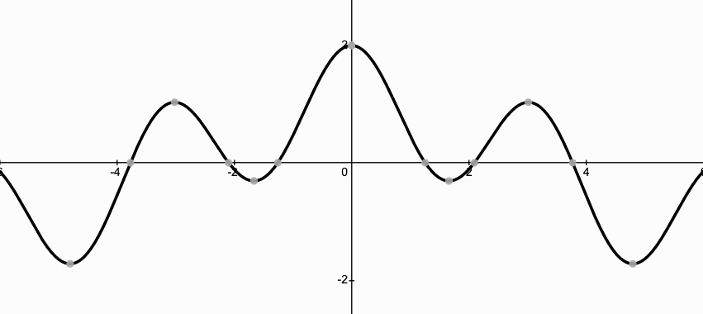
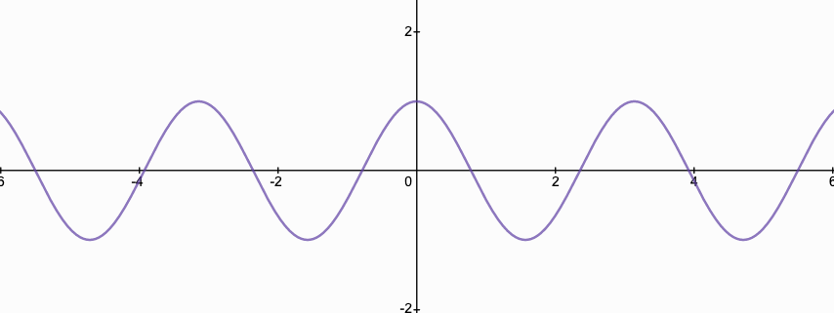
Signal Components?

Slide 22
Signal Components?
“No” (spoken loudly)
?
?

Slide 23
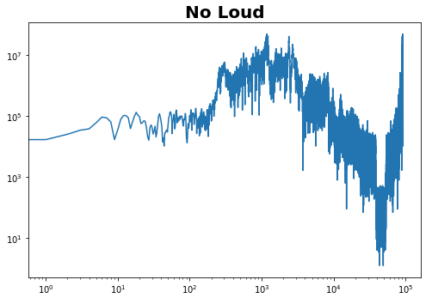
Signal Components?
FFT
Frequency
Time

Slide 24
Data Preprocessing
Notes:
Sliding window for spectrogram

Slide 25
Data Preprocessing
Notes:
Sliding window for spectrogram

Slide 26
Data Preprocessing
Notes:
Sliding window for spectrogram

Slide 27
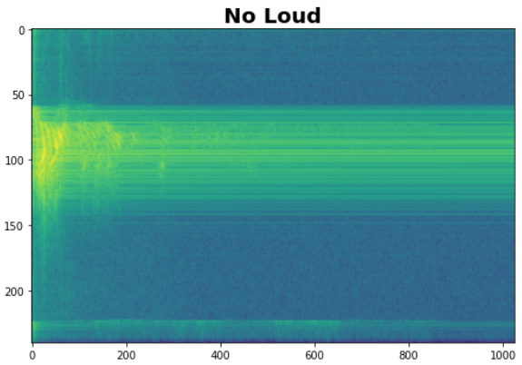
Data Preprocessing: Spectrograms
Notes:
A spectrogram is a visual representation of the different signal frequencies as it changes over time.

Slide 28
Data Preprocessing: Spectrograms
Notes:
But audio stream is low dimensional and thus harder to train on (even if we normalize for volume) --- we can get more interesting / easier to see differences by transforming it into a spectograms because pictures of audio (we move it into a higher dimensional thing that is easier to parse by a NN … instead of an infinite stream of noise we get a snapshot of audio as an image)
Note: Next is a reading/colab on how to get a spectogram and lets the students play with it so stay high level here

Slide 29
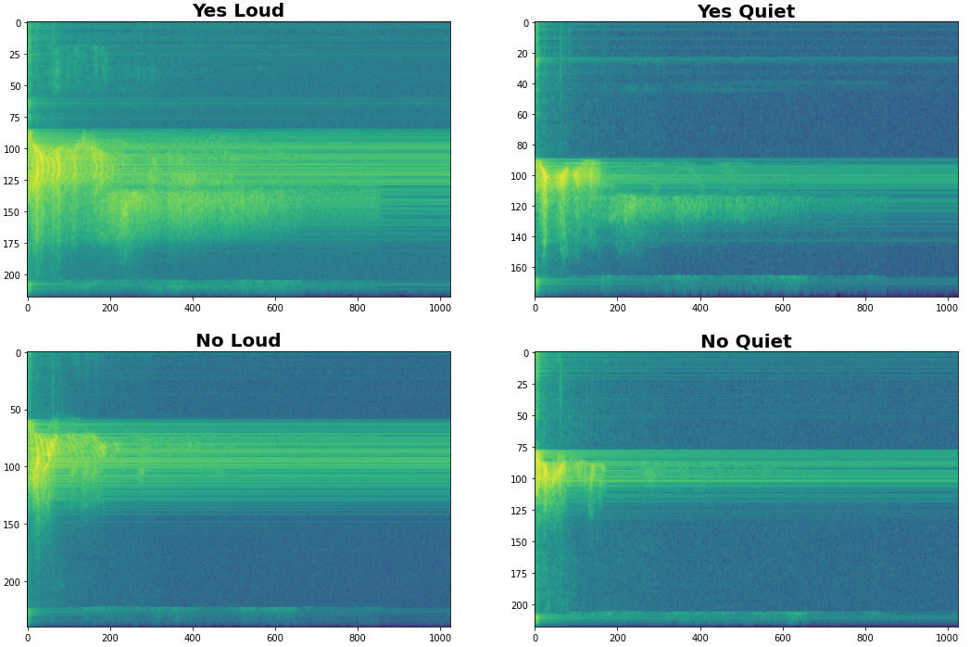
Data Preprocessing: Spectrograms
Notes:
But audio stream is low dimensional and thus harder to train on (even if we normalize for volume) --- we can get more interesting / easier to see differences by transforming it into a spectograms because pictures of audio (we move it into a higher dimensional thing that is easier to parse by a NN … instead of an infinite stream of noise we get a snapshot of audio as an image)
Note: Next is a reading/colab on how to get a spectrogram and lets the students play with it so stay high level here

Slide 30
Data Preprocessing: Spectrograms
Notes:
But audio stream is low dimensional and thus harder to train on (even if we normalize for volume) --- we can get more interesting / easier to see differences by transforming it into a spectograms because pictures of audio (we move it into a higher dimensional thing that is easier to parse by a NN … instead of an infinite stream of noise we get a snapshot of audio as an image)
Note: Next is a reading/colab on how to get a spectogram and lets the students play with it so stay high level here

Slide 31
Can we find more
salient features?

Slide 32
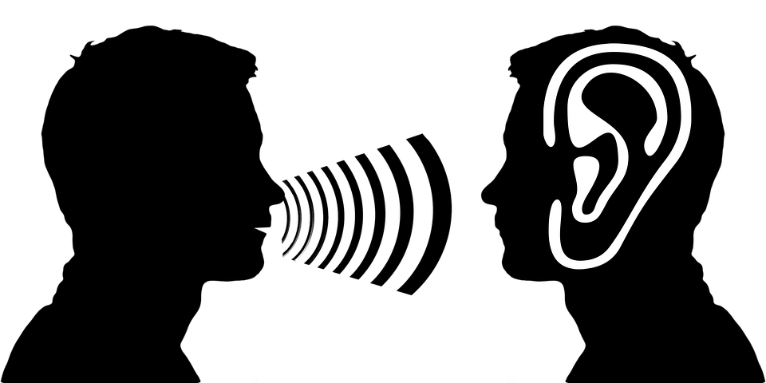
Notes:
Humans don’t hear all noises equally --- in fact we can tell apart low frequencies easier than high frequencies -- and very close frequencies often sound the same --- unless you have perfect pitch!
https://pixabay.com/illustrations/ear-auricle-listen-listen-to-2973126/

Slide 33
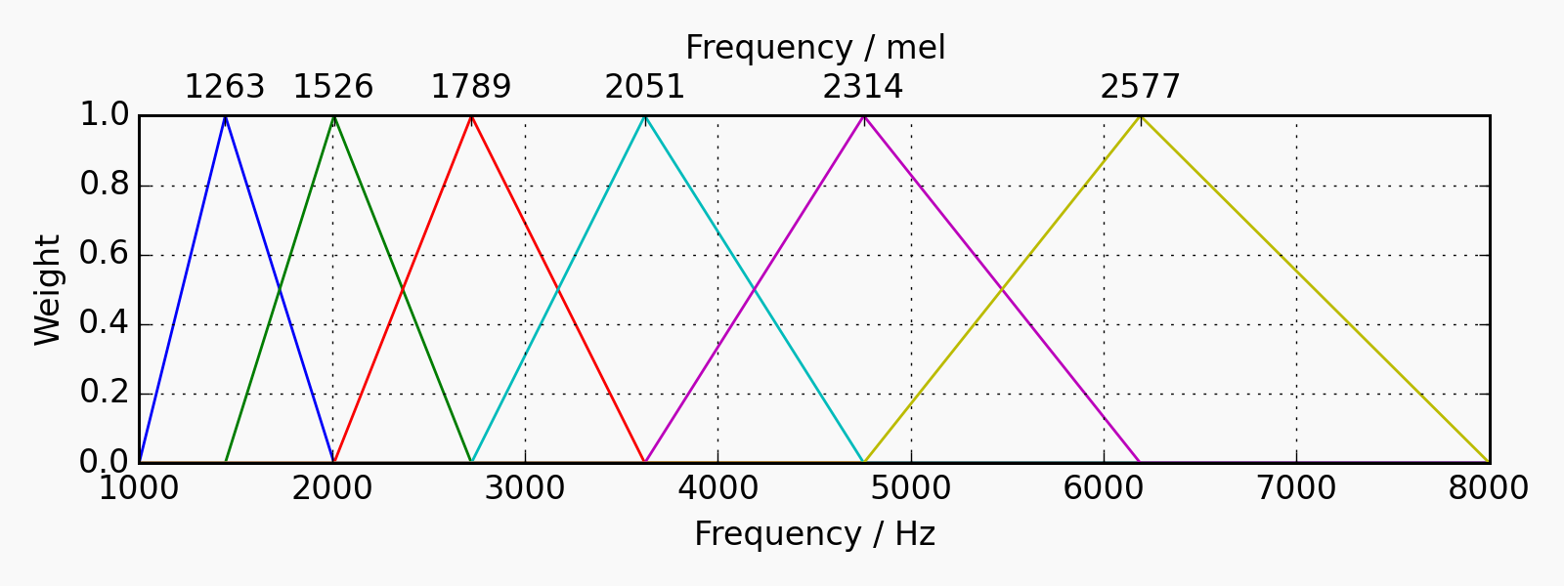
Mel Filterbanks
Notes:
We can use Mel Filterbanks to bucket frequencies according human perception! Grouping higher frequencies together. This not only better accounts for human hearing but also gives our machine learning models few - more salient features - making learning easier! This forms what are called MFCCs
CHART: http://siggigue.github.io/pyfilterbank/melbank.html
License
_______
pyfilterbank is licensed unter the BSD 4-clause license:

Slide 34
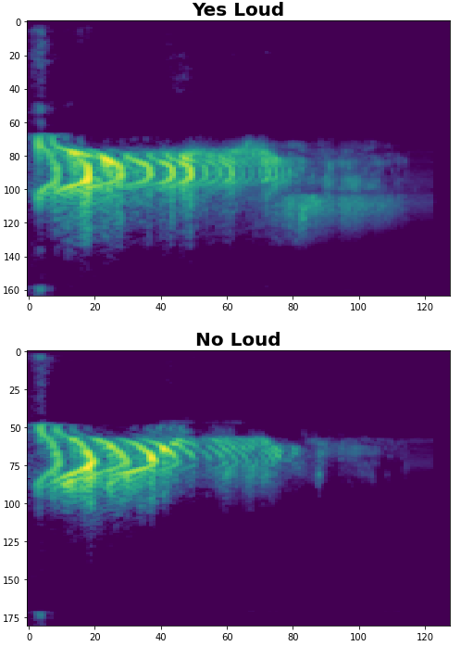
Spectrograms v. MFCCs
Notes:
On the left we have spectrograms and on the right MFCCs ---- hopefully the MFCCs will be clearer!
Mel-frequency cepstral coefficients (MFCCs) are coefficients that collectively make up an MFC.

Slide 35
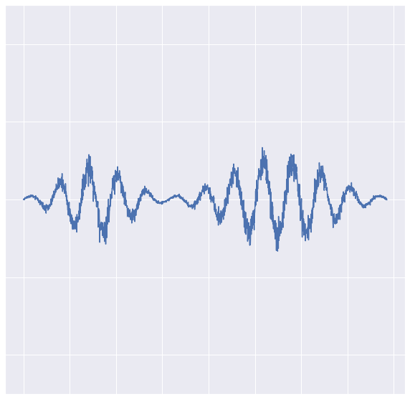
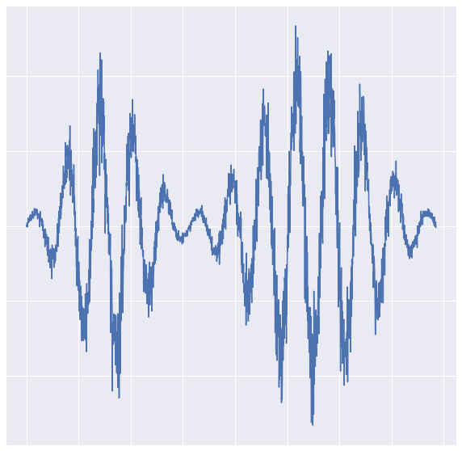
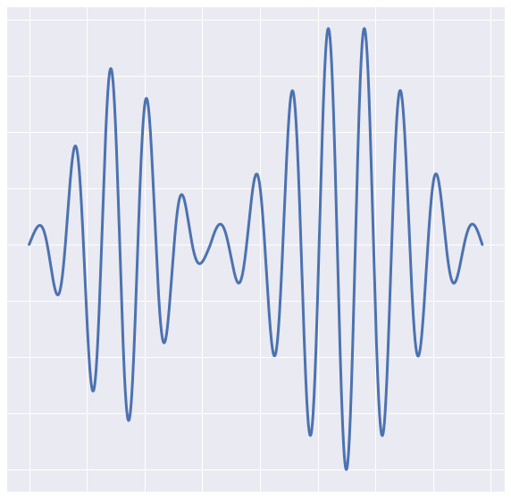
Additional Feature Engineering
Normalization: remove volume differences
Denoise: reduce background noise for clarity
Notes:
Additionally we can apply some simple classical techniques to improve the quality of our input audio which has HUGE impacts for small models! (Pete wanted us to land on that its more important for small models point)

Slide 36
Notes:
Next we’re going to dive deeper into how spectrograms are made and you’ll get a chance to record your own audio samples and compare the waveforms and spectrograms in Colab!

Slide 37
Data Collection

Slide 38
Sensor Data
16Khz signal
Notes:
Microphone --- how does it work -> ANALOG SIGNAL!!!!

Slide 39
Sensor Data
16kHz signal, so that’s 16000 samples points / second
How do you feed all that data into the network
Need to think creatively about the input signal
16Khz signal
16Khz signal

Slide 40
Data Preprocessing
Notes:
Then need to take the analog signal and bin it to convert to a digital signal the computer can recognize
Maybe make a note that higher quality audio has more bins? Different hardware have higher qualility A2D hardware?

Slide 41

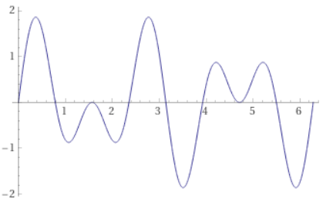
What is a Signal Composed Of?

Slide 42
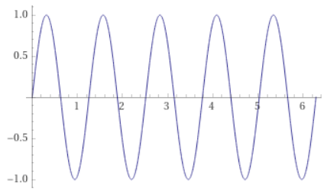
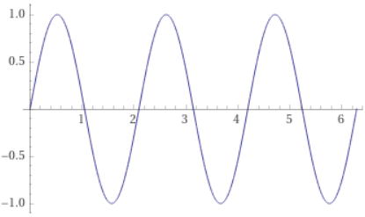
What is a Signal Composed Of?

Slide 43
Signal Components?

